Slide 1
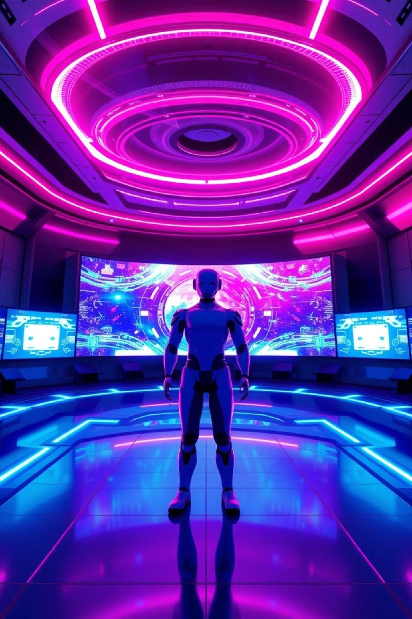
Symposium: Talking with Virtual Minds
1-1 live conversation with visionary leaders

Slide 2

THE CHALLENGE
🤖 Consistent character avatars
🌆 Stable, tone-matched backgrounds
🎭 Emotionally unified storytelling
🎥 High-quality narrative flow and audiovisual sync
🛠️ Solving for Consistency, Stability, and Tone
🧍‍♂️ Consistent Avatars: Character Creator 4 + Unity ensures stable, high-fidelity avatars with expressive yet consistent facial features.
🌆 Stable Backgrounds: Pre-defined, theme-matched scenes rendered in a unified visual style; transitions controlled via Unity Timeline.
🎙️ Unified Tone: Emotion-matched voiceovers (via ElevenLabs) and AI-generated scripts maintain narrative and emotional coherence.

Slide 3
Building Emotionally Intelligent Interactions
Simposium is a virtual summit where AI avatars of real-world leaders deliver emotionally tailored responses, creating a dynamic, immersive experience.
Mood Selection
Emotional Avatars
Dynamic XR Scenes
Users select a mood like Hopeful, Worried, Curious, or Excited to shape the interaction.
AI leaders (e.g., Sam Altman) respond with emotional nuance, generating unique dialogue.
Background scenes evolve dynamically based on topics discussed, creating a resonating, personalized interaction.

Slide 4

Unleashing the Power of Dynamic AI
Simposium is more than a video—it's an immersive simulation where everything adapts live.
Emotion-Driven Dialogue
GPT/Claude tailors speech based on the selected mood.
Emotion-Matched Voice
ElevenLabs voices respond in the right tone.
Realistic AI Avatars
Character Creator 4 avatars with facial animation & gestures

Slide 5





System Flow: From Emotion to Expression
Choose Emotion
User selects an emotion (e.g., Curious).
Generate Tone-Matched Speech
Claude/GPT generates speech for the AI leader.
Express with Emotional Voice
ElevenLabs generates voice with emotional expression.
Detect Keywords/Themes
Speech segments parsed to detect themes (e.g., healthcare, space).
Trigger Scene Changes
Unity triggers scene changes based on keywords.

Slide 6
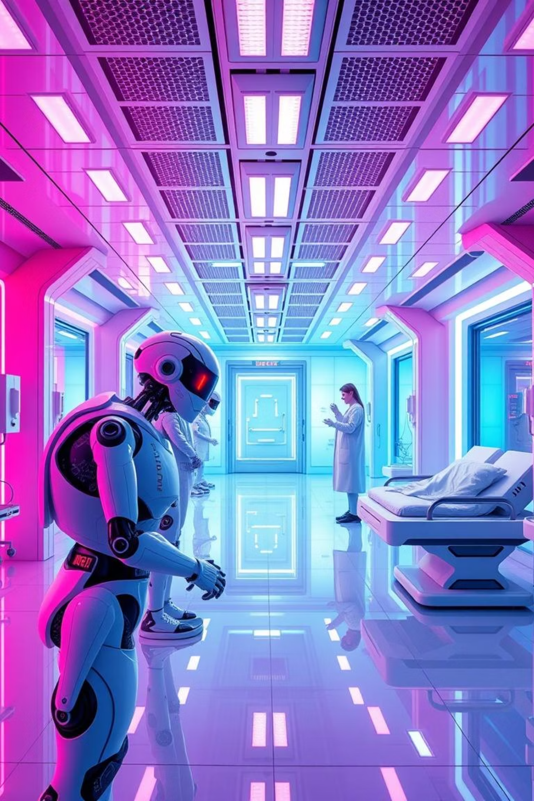
Live Example: Scene & Emotion in Sync
Watch how our avatars engage with viewers in a conversation with the future, transitioning backgrounds and slides to match the emotional context.
Avatar: “Artificial Intelligence will redefine how we care for each other…”
Background transitions to a futuristic medical facility.
Avatar: "...and help us colonize the stars.”
Scene shifts to Mars, satellites orbiting, AI drones at work.
Avatar: “But we must also ensure it aligns with humanity’s values.”
Background dims into a UN-style AI ethics summit.
Camera pans, slides auto-fade in—like a live keynote powered by AI emotion and meaning.

Slide 7

The Innovation Edge
What makes Simposium stand out from the crowd?
Multimodal Integration
Voice + Vision + Emotion + Storytelling = Fully immersive.
Seamless AI Pipeline
Claude + Unity + Voice AI = Text to Emotional 3D Presentation.
Lifelike Interactions
Convai enables avatars that "speak back" and react in realtime.
XR-Ready
Runs on desktop, future-ready for VR/AR classrooms or kiosks.

Slide 8

Vision & Impact
Simposium is more than a hackathon project—it's a gateway to the future of education, policy, and AI communication.
Potential Use Cases
AI & Society modules in schools
Policy simulation tools for governments
Interactive XR exhibits in tech museums
Content creation for AI education channels
Startup keynotes powered by avatars

Slide 9




Team Simlink
Let's demo a conversation with the future. Q&A—or tell us what emotion you want to hear from the future!
Unity Dev
Prompt Engineer
Expert in creating immersive 3D environments.
Dialogue engineer skilled in crafting AI interactions.
Avatar Designer
Convai Integrator
Skilled in creating realistic avatars with Character Creator 4.
TTS Integrator

